Slide 1
Lab 1: Printed Circuit Boards: Layers, Layers, Layers

Slide 2
Eagle Trick: The Command Line
You can type commands to Eagle. For some things it’s a huge help
Type “help <command>” to get help
There’s a command for each of the tools in the tool palette.
Useful commands for routing
Auto – run the auto router
Ripup – unroute signals
Show – Highlight a net or part

Slide 3
PCBs are Made of Layers
Silkscreen – documentation labels
Metal – for making wires
Dialectric – insulation and structure
Solder mask – protective outer coating

Slide 4
Metal Layers
The Metal layers for several components
Conductive “traces” to connect components
Pads for attaching/connecting components
N-layer boards have N metal layers
N usually is 2,4,...
Fewer layers → cheaper
Top and bottom layers are for mounting components and routing traces
Internal layers can serve several purposes
Ground and power planes
Other signal planes
Internal routing layers

Slide 5
Metal Layers (cont.)
Thickness is measured in oz per square foot.
Standard copper is 1oz
About 0.034 mm
Thicker metal layers can carry more current

Slide 6
Dielectric
The dielectric in the insulator between metal layers
Most PCBs use FR4
“glass reinforced epoxy laminate”
i.e., fancy fiberglass
“FR” means “flame retardant”
Other specialized dielectrics are are available
To support high speed circuits
To manage thermal expansion

Slide 7
Solder Mask
The solder masking is a polymer (plastic) coating on the top and bottom of the board
Solder does not adhere to it.
It serves several needs
Protects the top and bottom metal from oxidation.
Helps prevent solder bridges
Gives the board color
FR4 is brown
Solder mask comes in several colors.

Slide 8
Silkscreen
It’s an opaque (usually) white epoxy or polymer
It provides documentation and markings
References designators
Part outlines
Logos
Serial numbers etc.

Slide 9
Making Connections Between Layers
Plated holes connect metal layers.
Drill a hole
Electroplate it with copper
The plating attaches to metal that the hole passes through

Slide 10
Pads and Vias
Vias are electrical connections
Usually very small.
Through hole pads accommodate through-hole parts
Even larger, mounting holes are possible

Slide 11
Designing Through-hole Pads
The diameter of the hole is smaller than the drilled hole
You need to add about 0.1-0.3 mm to the desired, plated internal diameter to get the drill diameter

Slide 12
Lots of Choices, in Theory
There are many, many choices when designing a PCB
We will get to make very few of them
Cheap, quickturn PCB manufacturers provide a standard setup. E.g.:
FR4
1oz copper
2 or 4 layers
A few colors

Slide 13
Resources
Videos of PCB Manufacturing
This one is very good and really thorough, but it’s too long to watch in class.
https://www.youtube.com/playlist?list=PL8zP8UuDk8a0ZNWiteC-7PHx1HCeBY0qB
White paper about board stackups
www.icd.com.au/articles/Stackup_Planning_AN2011_2.pdf

Slide 14
Steps for Designing PCBs
Create/acquire a library of components
Assemble your schematic
Lay out the board
Perform design checks
Generate CAM files
Perform more design checks
Submit for manufacturing

Slide 15
Units
Units
We will mostly use mm in this class.
1mm is about 40mils (39.3700787, actually)
1in is 25.4 mm.
Keep an eye on your units.
Exceptions
Lots of tutorials, documents, etc. use mils (1/1000 of an inch) or inches.
Breadboards and headers are typically 0.1” spacing (2.54mm)
Mars Climate Orbiter

Slide 16
Designing with Layers
Eagle (and other board design tools) use layers to specify different types of information about a board. E.g:
Where wires should go on each physical layer
Where wires should not go on each physical layer
Documentation
Mechanical information
Eagle defines 52 layers by default
‘t’ prefix means top.
‘b’ prefix means bottom (displayed mirrored)

Slide 17
Eagle Layers
Top | Tracks, top side |  | 27 | tValues | Component VALUE, top side
Route2 | Inner layer |  | 28 | bValues | Component VALUE, bottom side
Route3 | Inner layer |  | 29 | tStop | Solder stop mask, top side (gen. autom.) |  | Design
Route4 | Inner layer |  | 30 | bStop | Solder stop mask, bottom side (gen. Autom.) |  | Documentation
Route5 | Inner layer |  | 31 | tCream | Solder cream, top side |  | Tool guidance
Route6 | Inner layer |  | 32 | bCream | Solder cream, bottom side
Route7 | Inner layer |  | 33 | tFinish | Finish, top side
Route8 | Inner layer |  | 34 | bFinish | Finish, bottom side
Route9 | Inner layer |  | 35 | tGlue | Glue mask, top side
Route10 | Inner layer |  | 36 | bGlue | Glue mask, bottom side
Route11 | Inner layer |  | 37 | tTest | Test and adjustment information, top side
Route12 | Inner layer |  | 38 | bTest | Test and adjustment inf., bottom side
Route13 | Inner layer |  | 39 | tKeepout | Restricted areas for components, top side
Route14 | Inner layer |  | 40 | bKeepout | Restricted areas for components, bottom s.
Route15 | Inner layer |  | 41 | tRestrict | Restricted areas for copper, top side
Bottom | Tracks, bottom side |  | 42 | bRestrict | Restricted areas for copper, bottom side
Pads | Pads (through-hole) |  | 43 | vRestrict | Restricted areas for vias
Vias | Vias (through all layers) |  | 44 | Drills | Conducting through-holes
Unrouted | Airlines (rubber bands) |  | 45 | Holes | Non-conducting holes
Dimension | Board outlines (circles for holes) |  | 46 | Milling | Milling
tPlace | Silk screen, top side |  | 47 | Measures | Measures
bPlace | Silk screen, bottom side |  | 48 | Document | Documentation
tOrigins | Origins, top side (generated autom.) |  | 49 | Reference | Reference marks
bOrigins | Origins, bottom side (generated autom.) |  | 51 | tDocu | Detailed top screen print
tNames | Service print, top side (component NAME) |  | 52 | bDocu | Detailed bottom screen print
bNames | Service print, bottom s. (component NAME)

Slide 18
Useful Layer Commands
“display <layer>” -- show the layer
“display -<layer>” – hide the layer
“display last” return to previous view
Click and hold the layer tool icon to get a list of present layers sets.
Select “new…” to save the current view
Then “display foo” to switch to the view named “foo”

Slide 19
Layer Demo
The “Red board”
open /Users/swanson/UCSD/Teaching/18sp-190/QuadClass-Resources/Lecture\ Slides/Examples/ATmega128RFA1-DevBoard/ATmega128RFA1-DevBoard.brd

Slide 20
Eagle Libraries

Slide 21
Libraries
Libraries define the parts you can add to a PCB
Eagle libraries contain 3 different kinds of entities
Schematic Symbols – The symbolic version of the part
Package – The physical description of the part and how it should appear on the board
Device – A combination of a package and a schematic

Slide 22
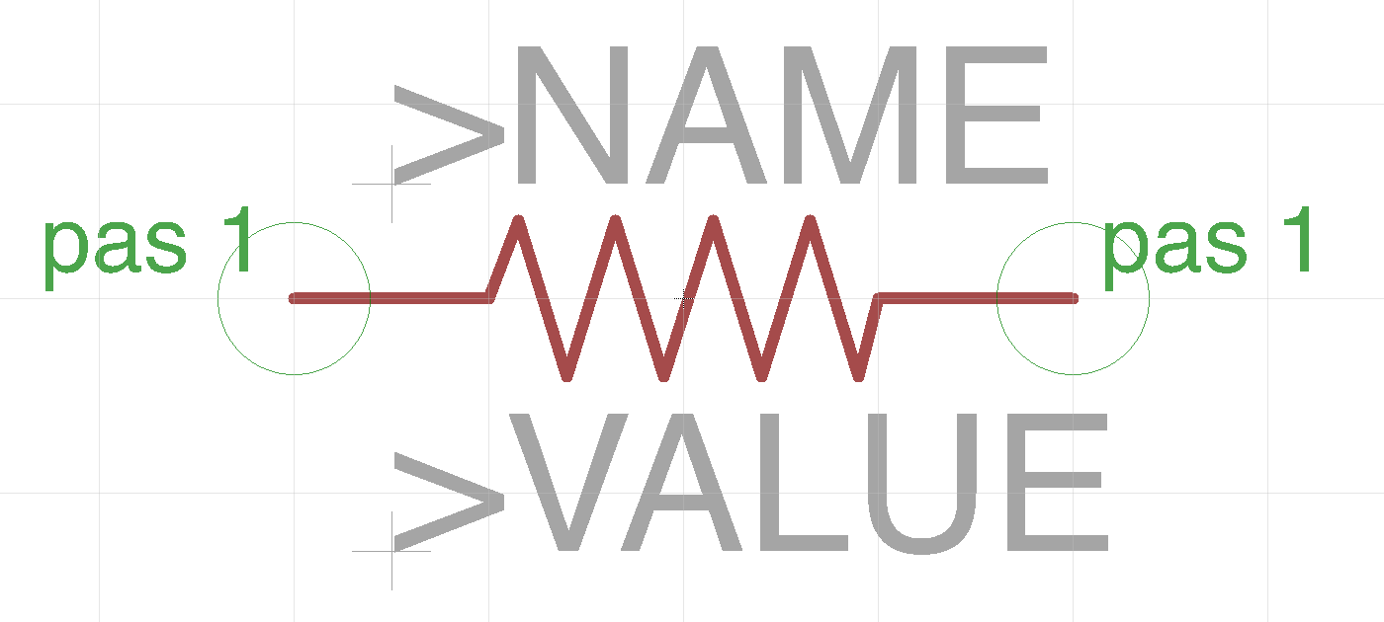
Example: A Resistor
Schematic symbol
Has the standard resistor “zig zag”
Two ‘pins’
Pas 1
Pas 2
And place holders for documentation
>NAME – e.g. “R6”
>VALUE – e.g. “200Ohms”

Slide 23
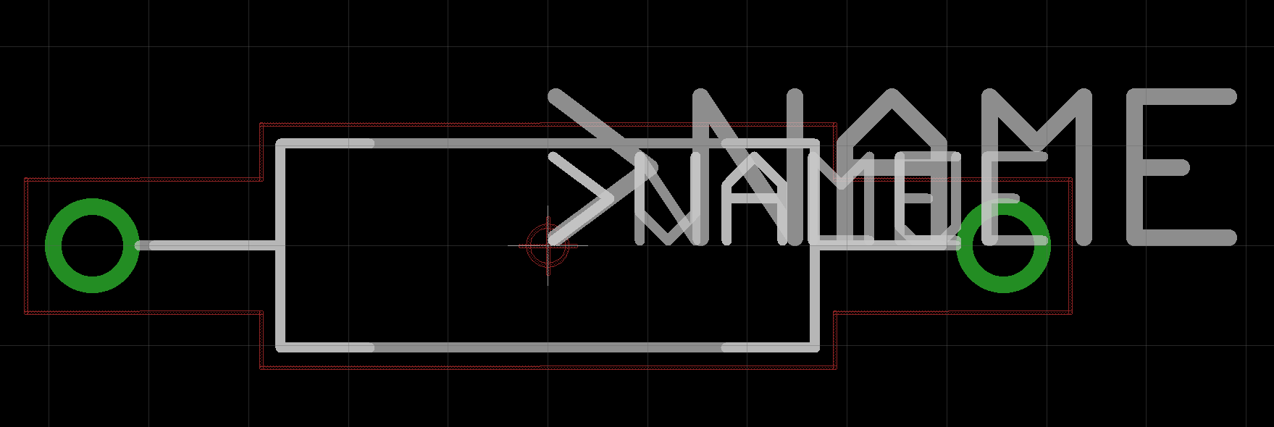
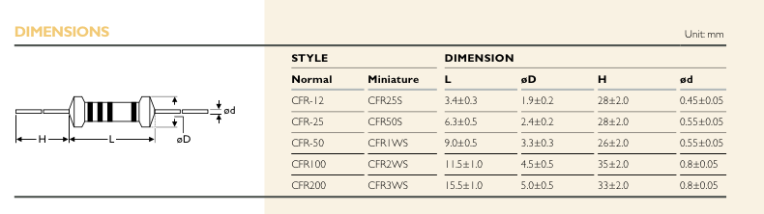
Example: A Resistor
Package
¼ Watt Yageo CFR Series through hole resistor
Two “pads” (through holes)
Silkscreen documentation
Outline
Name
Keep out area – Where other parts should not be!

Slide 24
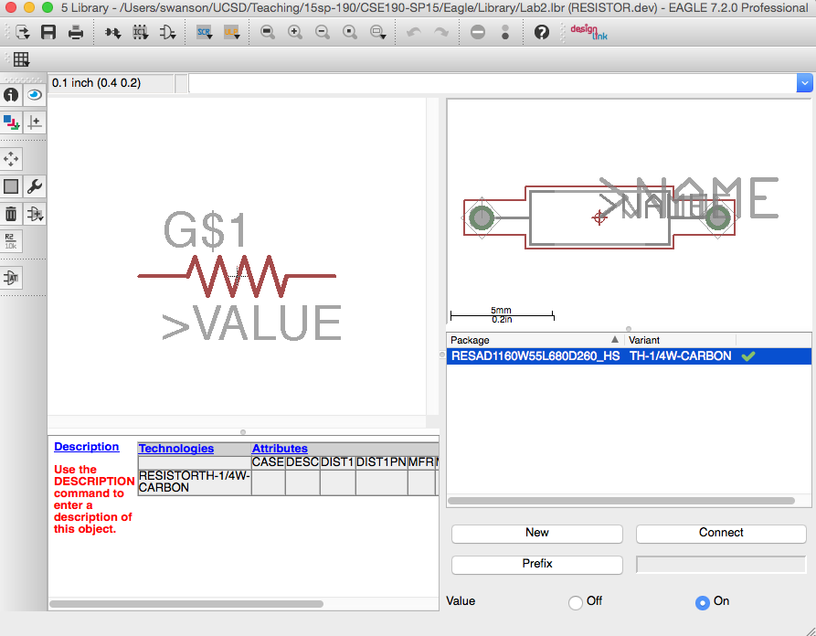
Example: A Resistor
The Device
Maps the symbol to the package
There can be multiple “variants”
Different packages
Same symbol
Same kind of device

Slide 25
Layers In Packages
Packages have the same layers as boards.
For packages “t” means device side, “b” means opposite side.
If you put the devices on the back side of the board (i.e., “mirror” them), “t” and “b” will swap.

Slide 26
Schematic Capture

Slide 27
Schematics Goals
Determine what components your PCB will hold
Define the electrical connectivity between those components
Specify some metadata about the parts

Slide 28
Schematic Example
open /Users/swanson/UCSD/Teaching/18sp-190/QuadClass-Resources/Lecture\ Slides/Examples/ATmega128RFA1-DevBoard/ATmega128RFA1-DevBoard.sch

Slide 29
Eagle Pitfalls
Always edit schematics with your grid set to 0.1” or 0.05” – ALWAYS!!!
Wires/pins can look connected but not be.
‘Wiggle’ parts to make sure wires move with them.
Check for the green dot.

Slide 30
Board Layout

Slide 31
Board Layout Goals
Mechanical constraints – Some things need to be in specific locations
Electrical constraints – Does the layout meet signal integrity/EM requirements
Will digital interference mess up the antenna?
Are decoupling caps near IC Supply pins?
Keep the noisy power/ground for the motors away from the digital logic.
Correctness – things don’t overlap or hang off the board.
Ease of routing – Connected items should be physically close.
Make it pretty – you want a nice looking board
Potentially other, design-specific requirements

Slide 32
Layout In Eagle
You can put things on the back of the board
Use the “Mirror” tool.
This will make assembly harder.
You can also move around the reference designator
Use the “squash” tool
You can rotate components with the rotate tool.

Slide 33
Layout Demo
open /Users/swanson/UCSD/Teaching/18sp-190/QuadClass-Resources/Lecture\ Slides/Examples/ATmega128RFA1-DevBoard/ATmega128RFA1-DevBoard-unplaced.brd

Slide 34
The Three Ways to Route
Manual
You can do anything you want (including things you shouldn’t)
Auto router
Fully-automatic routing, subject to constraints that you can set.
“Follow me”
Assisted manual routing. The router will enforce the constraints you set.
Subject configurable cost functions.
More control.

Slide 35
Manual Routing Demo

Slide 36
Auto Router
Mixed reputation
It can’t do everything
Sometimes it does a bad job
When it works, it’s great.
Usually it needs some touch up.
Net classes (“Edit->Net Classes…”)
Lets you set parameters for different kinds of nets (mostly width and clearances)
Lots of parameters to mess around with
Optimization phases
Routing grids
Effort levels
Concurrency
Staged routing
Checkout the Eagle Manual

Slide 37
Follow Me Router Demo

Slide 38
Auto Routing Demo

Slide 39
Commands for Routing
“Auto;” – run the auto router (leave off the “;” to configure the router.
“Ripup;” – unroute signals
“Show <thing>” – Highlight a net or part

Slide 40
Electrical Rules Check
This checks for common problems in schematics.
Make sure you understand the reason for the errors.
Fix them if you can.
Run it!

Slide 41
Design Rules Check
Checks that your board layout meets design requirements for manufacturing.
Distance between traces and traces, traces and vias, etc.
Trace width
Etc.

Slide 42
CAM Layers (Gerber files)
Eagle layers are for design.
CAM layers are for manufacturing
“Gerber” files are for lithographic steps
Drill files are for drilling holes.
Each CAM layers corresponds to one layer of the resulting board
Top silk screen (.PLC)
Top solder mask (.STC)
Top metal (.TOP)
Inner metal layers
Bottom metal (.BOT)
Bottom solder mask (.STS)
Bottom silk screen (.PLS)
Different board houses have different suffixes.
One drill file specifying where all the pads, vias, and mounting holes are located and their diameters (.DRD)
Other files too, depending on the manufacturing process
Solder paste stencil
Assembly drawings

Slide 43
The CAM Processor
The CAM Processor generates CAM files
The exact configuration for the gerber files varies by board house
Should the board outline be in every layer?
Which format should the files be in (there are many)
Should the back side layers be mirrored?

Slide 44
CAM Setup
To prepare Gerbers for a particular board house, you need CAM setup files (*.cam for Eagle)
This specifies how to generate each layer the board house needs.
See example in Button and Light Tutorial.

Slide 45
CAM Demo

Slide 46
Checking Your Gerbers!
Eagle can’t display Gerber files itself
You need a 3rd party tool
See the Button and Light tutorial for recommendations
You should always check your Gerbers!
Eagle has bugs (I assume)
You may have misconfigured something
You may have put something in the wrong layer.

Slide 47
Gerber Viewer Demo

Slide 48
DFM Checks
You should also run a “design for manufacturing” (DFM) check on your Gerbers, if possible
Freedfm.com will do this for you.

Slide 49
FreeDFM Demo

Slide 50
The Lab
Use Eagle to design a simple schematic and board.
Run it through the tool flow.
https://sites.google.com/a/eng.ucsd.edu/quadcopterclass/labs/lab-2-using-eagle

Slide 51
Eagle Lint
lint:
Tool to check coding standards and other invariants about a computer system.
Eaglint will check your libraries, schematics
Check for common problems
Check for correctness
Check for style
Also checks for other files in your repo
Eaglint will tell you what it’s looking for.
Pay attention.
Provides a workflow for me to review your designs and provide feedback.
To use
Visit http://eaglint.nvsl.io
You received a welcome email a couple of nights ago.

Slide 52
Eagle Lint Process
Commit and push your changes to github
Submit your repo to Eaglint for a quick check
Submit your repo to Eaglint for a full check
If warnings/errors
Fix and goto 1.
Or justify them and goto 5
Submit for human review
If rejected
Read comments; goto 1.
Else if accepted
Goto next lab

Slide 53
Grading on PCB Labs
The key to PCB design is attention to detail.
Building a real board can take 4 months.
If you make a mistake, it takes 4 months to fix.
Contrast to software: just recompile and rerun!
Don’t make any mistakes! Check your work!
Grading for PCB labs
A “perfect” score is 10 points
You start out with 15 points.
Every time you submit a design to Eaglint, you lose a point.
Every time you submit a design for human review Eaglint, you lose a point.
For every day late, you lose a point.
You must complete the labs.
”Quick checks” are free.

